Slide 1
TEMPO Science Team Meeting at Washington D.C.
Wendy Pennington
NASA LaRC
TEMPO Instrument Project Manager
David Beals
NASA LaRC
TEMPO Mission Project Manager
Capt. Avery Merriex
USAF AFSPC/ADSH
HoPs Program Manager
June 1, 2016

Slide 2
Agenda
TEMPO Instrument Project Status
TEMPO Mission Overview and Progress

Slide 3
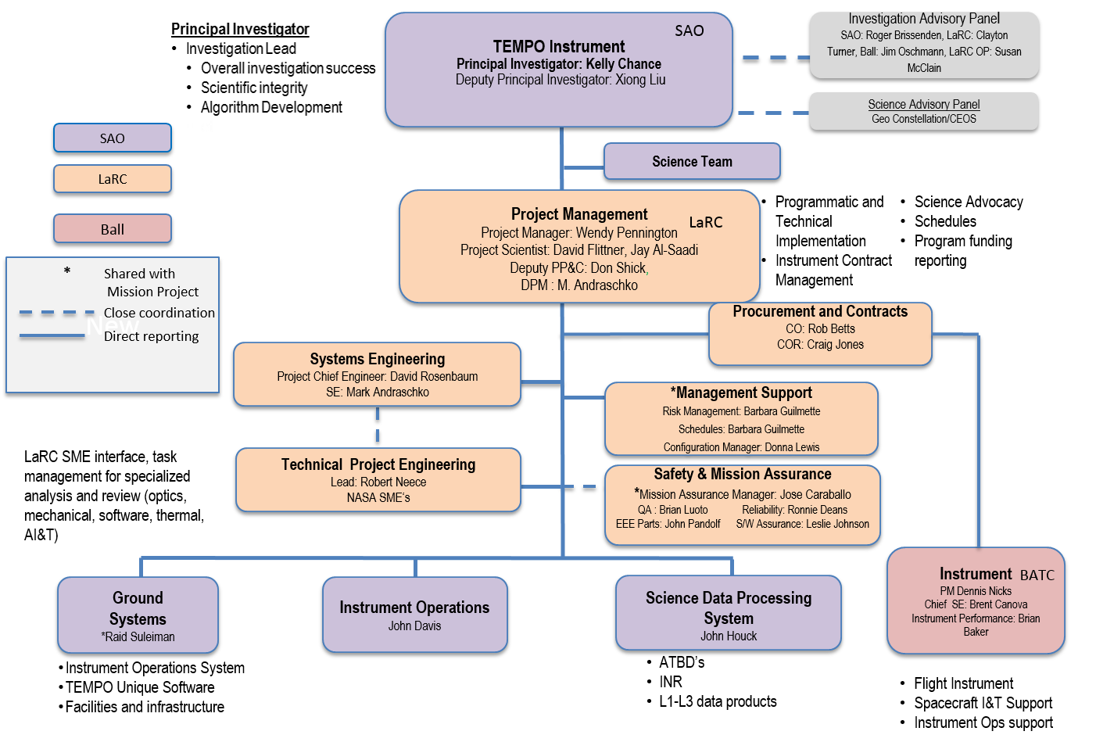
TEMPO Instrument Project
Detailed Organization Structure Structure

Slide 4
GS CDR Executive Summary
This was the CDR for the TEMPO Instrument Project Ground System
  CDR for Instrument was held July 2015
Project rated on a 5-level color scale for the six 7120.5E success criteria
  Green: Agency Goals, Technical Approach, Budget & Schedule, Resources other than Budget, Risk Management
  Green/Yellow: Management Approach
SRB Chair added two persons with specialized ground system and operations experience
SRB noted that the PI team from SAO has robust experience for ground system development and science data processing
SRB assigned 5 Requests for Action, 4 Advisories, no issues.
None of the RFA are schedule-critical; SRB Chair requested the Project provide reasonable due dates
From SRB Chair Outbrief

Slide 5

Engineering Score Card
Tech | Sched | Area | Comments
 |  | Overall Assessment | Instrument technical issues have been resolved or are in a resolution process that fits within the schedule. GS CDR successfully completed.
 |  | Systems Engineering | Directed CC/M&P/MMOD SME replacement plan will result in no ability to transition to new SME and loss of corporate knowledge. Working with management to identify options to address the incurred risk associated with this that TEMPO does not have the authority to manage. 06Apr16 meeting with Ed Healy to discuss provided options. 29Apr16 meeting with Ed Healy identified progress but work is still ongoing to resolve the concern. I am cautiously optimistic of an acceptable resolution.
 |  | Instrument | Detectors: Both flight CCDs have been installed on baseplate and wire bonded to the CCD Interface board. Detector Radiation Degradation Factor: Review of updated radiation model and analysis SERs is in progress. Albedo Calibration: Resolution path of more diffuser testing/calibration at GSFC and augmentation of the existing Instrument TVAC testing is being implemented. Verification planning meetings used to define the details. Started testing the Ball-provided mock diffuser in mid-April to inform the test set up and provide an opportunity to better inform/optimize the test matrix. GSFC has safely received the flight working diffuser and holding fixture and will start testing this week and complete by the mid-Sep16 need date. CMA: Working diffuser removed and shipped to GSFC. SMA: Functional testing complete. In TVAC. Spectrometer: Ready for optics installation. Telescope Structure: Assembly and test at AASC complete.
 |  | Instr to S/C Interfaces and Environments | Host studies: Individual meetings with each vendor continuing. Using studies to evaluate opportunity to operate detector colder. Supporting personnel transitions.
 |  | Ground Systems (IOC/SDPC) | GS CDR successfully completed3-4May16. 5 RFAs, 4 Advisories
LEGEND DEFINITIONS
Green. Progress according to plan. Meeting management plans or commitments. No action required.
Yellow. Area of concern. Deviating from plans or commitments, but approved contingency/reserves exists to recover and successfully complete the program/project as approved. Needs attention. Problem can be resolved within the reporting organization.
Red. Significant problem. Deviating from plans or commitments, with insufficient approved contingency/reserves to recover and successfully complete the program/project as approved. Needs action.
Schedule Rating Basis: if anything is happening in the schedule that looks like it its resolution could impact technical
16 May 2016
Center Management Council
5

Slide 6
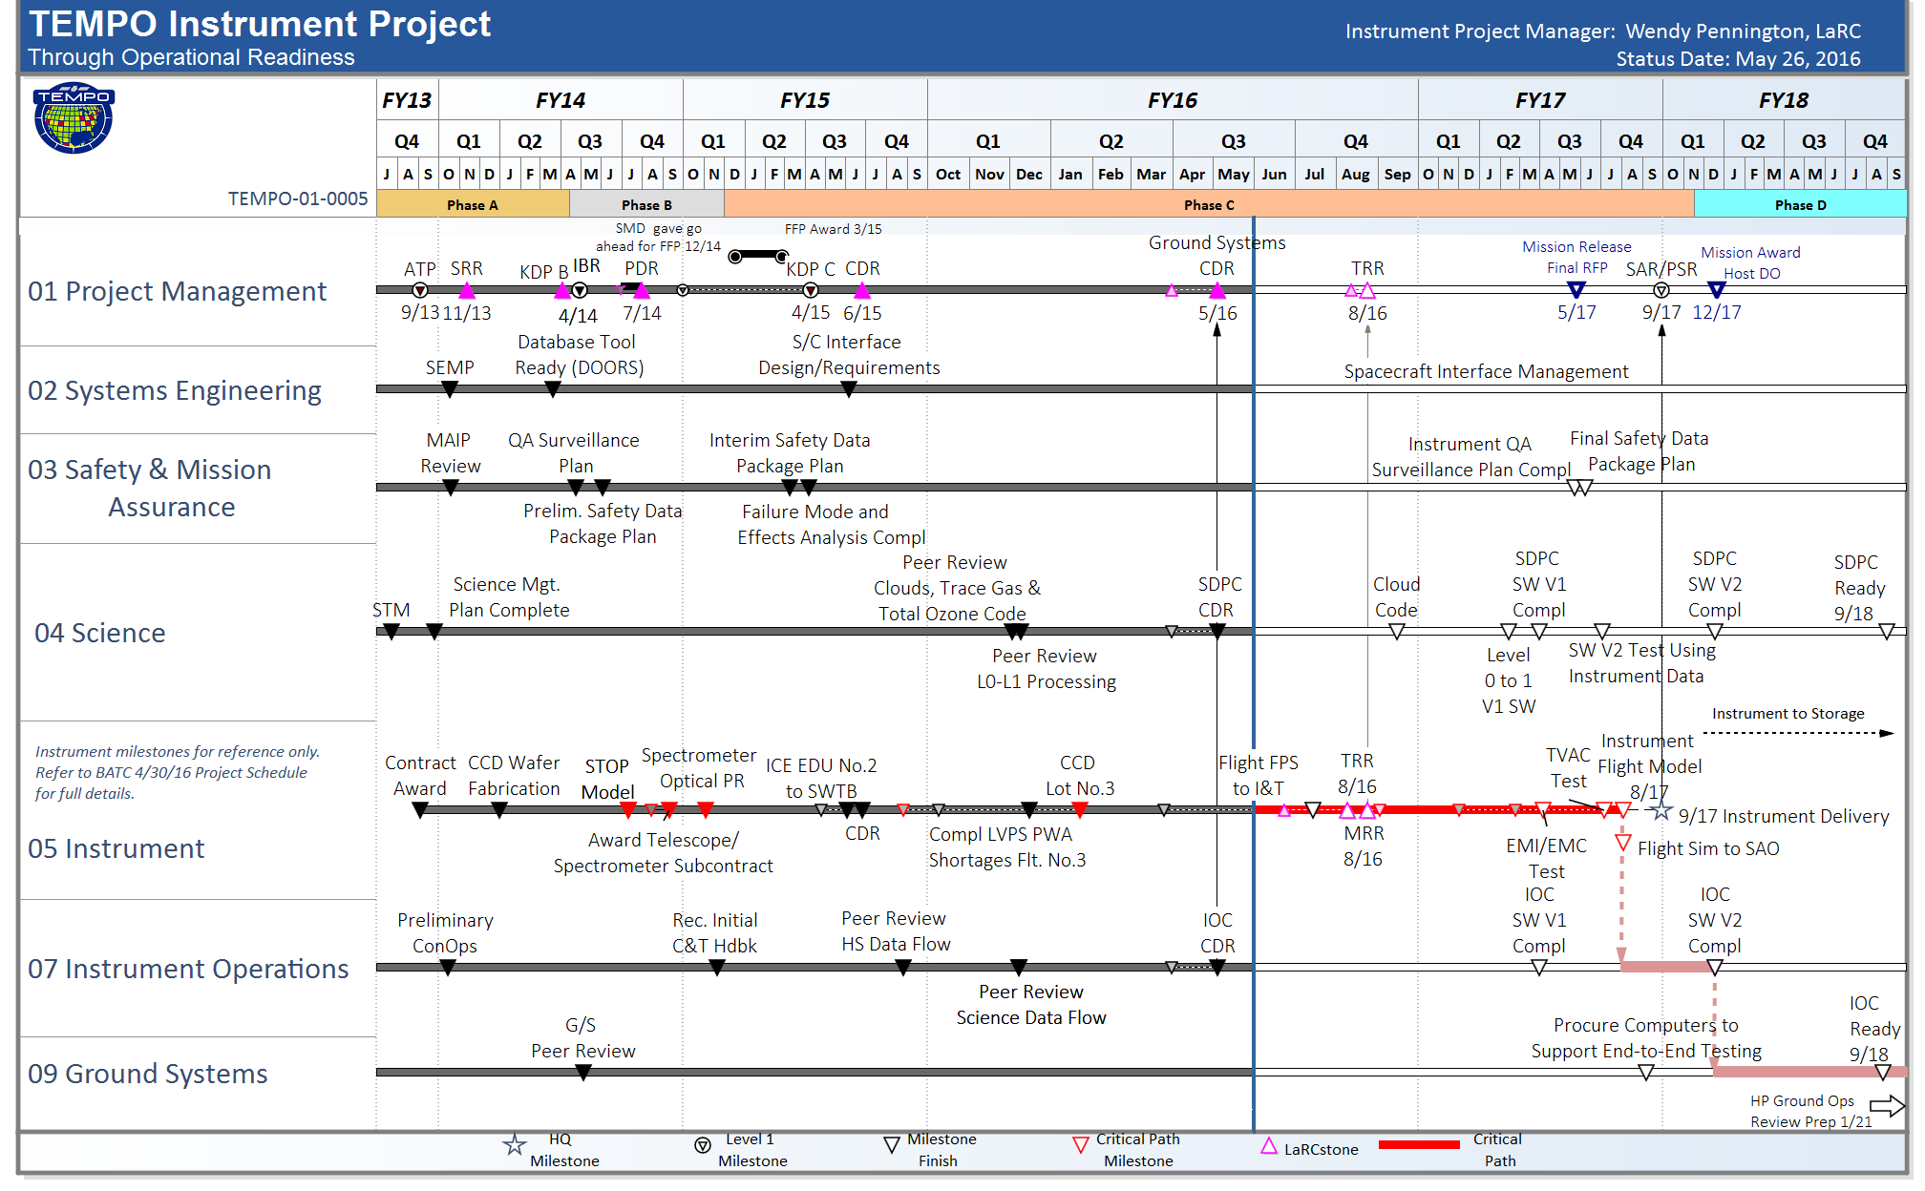
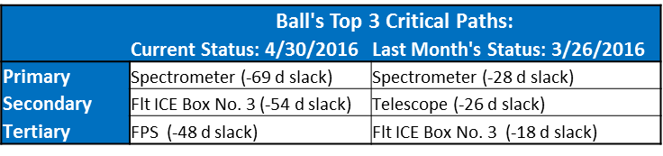
TEMPO Instrument Project IMS

Slide 7


Instrument Project Risk Summary
⬇
TEMPO Instrument Project Risks:
“Red” Risks
(No change)
“Yellow” Risk
(No change)
“Green” Risks
(No change)
0
2
2
03: Ozone Retrieval Performance
24: Maturity of Formaldehyde Validation Measurements
25: Data Correction to Compensate for Reduced Detector Performance
23: Availability of Pandora Ground-Based Validation Measurements
0
“New” project risks validated
0
“Closed” project risks
TEMPO TOP WBS 05 SPECIFIC RISKS:
Below risks have been evaluated by RCB, TEMPO Chief Engineer, &
project management and determined to not meet elevation criteria.
□
5101: High FPE Read Noise
0556: Scan Mech Calibration
0536: Spectral Features
0543: E/W GSD
5102: TEMPO Spectrometer Alignment
5110: Telescope Focus (MTF) & CME
0544: Spectrometer Slit Width
0520: N/S MTF
5111: Instrument Radiated Susceptibility Outages
5113: Structure Composi-locks impact on STOP results
5115: Test risk due to lack of S/C coupled loads analysis

Slide 8
Mass Trend

Slide 9
Power Trend

Slide 10
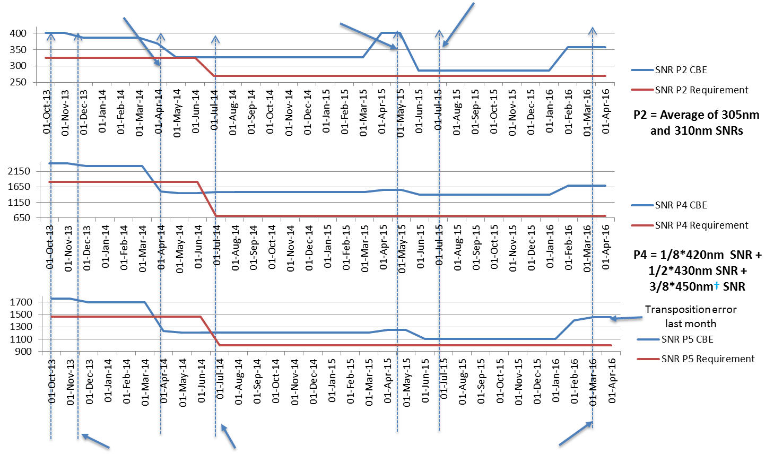
SNR Trends
Performance Issues Identified
Pre-CDR Roll-up Prior to Realizing Dark Current Issue
Dark Current Issue Realized
P5 = Average of 540nm, 600nm, and 650nm SNRs
Instrument Contract Award
SRR/MDR
Performance Improvements Realized, Detectors Selected
† Was 460nm before Requirements Relaxation
Requirements Relaxation Provided

Slide 11
TEMPO Mission Overview
David Beals
NASA LaRC
TEMPO Mission Project Manager
May 10, 2016

Slide 12
TEMPO Mission Organization
ESSP PO
Director: Greg Stover
Deputy Dir: Christina Moats-Xavier
TEMPO Mission Manager: Brad Crawford
TEMPO
PI: Kelly Chance
Deputy PI: Xiong Liu
Program Administrator: Joseph Webber
Science Team
Mission Management
Mission Project Manager: David Beals
Coordination of Mission activities
Color code
Instrument Project
Lead Systems Engineer
Eric Roback
Management Support
Schedule Lead: Barbara Guilmette
Configuration Manager: Kennedy Delgado
Resources: Don Shick
Risk Manager: Barbara Guilmette
Requirements Management: Suzy Maddock
Mission Project
Legal
Eric Rissling
Safety & Mission Assurance
SMA Manager: Jose Caraballo
Procurement
Cynthia Cowan
Instrument
Instrument PM: W. Pennington
Instrument DPM/COR: TBN
CE: Dave Rosenbaum
Project Scientist: David Flittner
Ground
System
Chris Brown
Mission Operations
Chris Brown
Host Satellite
Andrew Panetta
I&T
Rick Jones

Slide 13

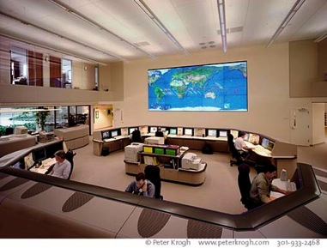
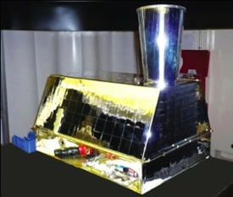


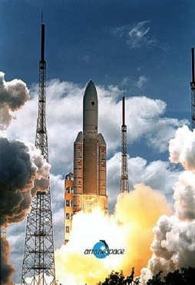
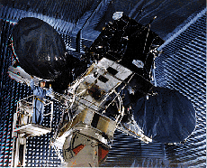
Commercially Hosted Government Payload Concept Overview
Commercial GEO satellite owners
NASA buys
access to space services
NASA buys operations and data services
Commercial space operations
and ground data services
hosted government payload
(Air Force CHIRP shown)
Owner
buys
Owner buys
Technical
data flow
commercial launch vehicle
customized commercial spacecraft
Technical
data flow
Notes:
In a nutshell.. Nasa buys instrument or instruments. We work through the owner operators in the center to procure a spacecraft and launch services, then we work with the owner/operators to collect and desiminate the data.

Slide 14
Messages from Satellite 2016
Industry is captive and ready as NASA is committed to the Hosted Payload concept and that there is the potential for future business. NASA wants to take advantage of commercial capabilities
  NASA is willing to be flexible and work with industry to make Hosted Payloads a good business deal for both industry and NASA
  The future NASA goal is to seek ways to move Hosted Payloads from a novelty to a routine business practice.
NASA desires a robust, competitive hosted payload market. Competition is key to NASA obtaining best price and best service.
The TEMPO project teams have had excellent interactions with the HoPs contract industry partners.
  Discussions have resolved technical issues – outstanding interactions and support from industry have resulted in in win/win design solutions for NASA and the vendors. Ongoing discussions and contracted accommodation studies help NASA and TEMPO achieve our requirements

Slide 15
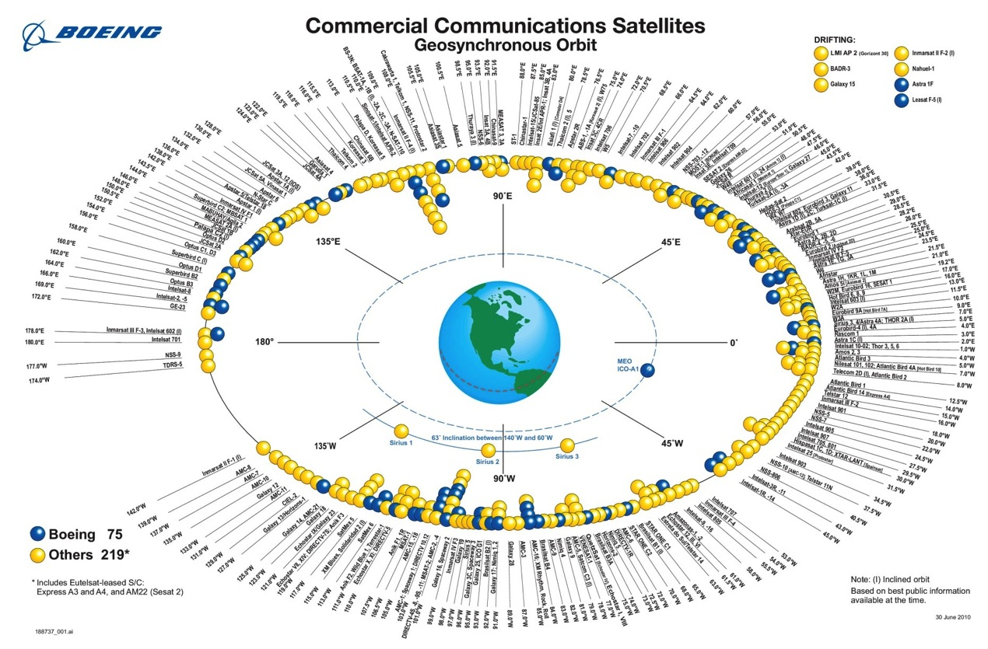
Geostationary Orbit Opportunities of Interest to NASA
(typical)
Between 90 W and 110 W, there are nine owner operators of 30 satellites including older models still used in this location:
  Direct TV Group (7)
  AGS (5)
  Intelsat (5)
  Telesat (4)
  Hughes Network Systems (3)
  Echostar (2)
  SkyTerra (2)
  Inmarsat (1)
  ICO Global Communications (1)
TEMPO
TEMPO can be located between 80 – 120 West
Notes:
The atmospheric instruments can accomplish their science objectives in orbit locations from around 110 W to 90 W
The ocean science instrument needs to be in an orbit location between 85 W to 95 W to accomplish its science objectives

Slide 16
Host Special Study Overview
TEMPO Host Special Study
The scope of this study effort is to provide NASA with additional interface and opportunities data to refine the TEMPO Instrument’s interface and mission design. Study contractors are requested to provide feedback and recommendations during the period of performance of the subject delivery order to support the TEMPO Hosted Payload Mission.
The objectives for this special study include the following:
Further refine the TEMPO instrument-to-host spacecraft interface requirements as needed to minimize integration cost and complexity. The anticipated focus areas may include: jitter, pointing, thermal, contamination, etc.
Provide listing of updated hosting opportunities.
Feedback and discussion of the acquisition and methods of making Hosted Payloads a viable business construct.

Slide 17
Study Participants
The following is a list of all the IDIQ vendors participating in this Study:
Intelsat
SES
Boeing
Space Systems/Loral
Surrey
Lockheed Martin
VivaSat
Orbital ATK
Eutelsat

Slide 18
Timeline of Events
July 10th 2014 – SMC HoPS IDIQ Award
July 22nd 2014 – TEMPO Accommodations Study Award
July 24th 2014 – First TEMPO Draft DO RFP Released
August 19th-21st – Pre-Solicitation Conference
August 4th-6th – TEMPO Accommodations Study Kickoffs
January 24th 2015 – TEMPO Accommodations Study Completion
February 20th 2015 – Second Draft TEMPO DO RFP Release
March 11th 2015 – HoPS Vendor Workshop
March 17th-18th 2015 – TEMPO One on One Meetings at Satellite 2015
April 13th 2015 - TEMPO Notice of Intent Released
April 10th 2015 – TEMPO Instrument KDP-C
April 30th 2015 - TEMPO NOI Feedback Received
May 2015 – Decision Made to Delay Release of RFP for Hosting
June 2015 – TEMPO Instrument CDR

Slide 19

Timeline of Events, Cont.
January 5th – TEMPO Special Studies Awards Complete
January 12th – Special Studies Kickoff Meeting
March 2016 – TEMPO One on One Meetings at Satellite 2015
May 2016 – TEMPO Instrument Ground System CDR
December 2016 – TEMPO Special Studies Complete
May 2017 – Expected Final RFP Delivery Order Release
November 2017– TEMPO Instrument Delivery to Storage
December 2017 – Expected Host Contract Award
December 2020 – TEMPO Instrument Delivery to Host
December 2021 – No Later Than Launch Date

Slide 20
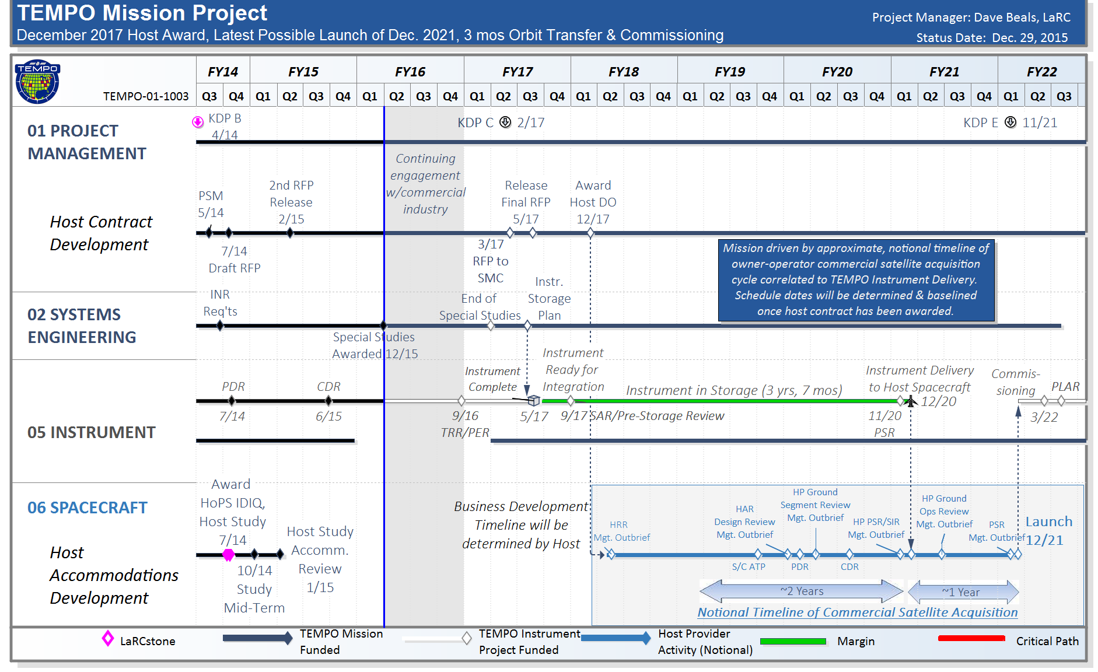
TEMPO Mission Project Schedule
Dec. 2017 DO Award, Dec. 2021 Launch

Slide 21
HOSTED PAYLOAD OFFICE (HPO) COLLABORATION WITH NASA ON TROPOSPHERIC EMISSIONS: MONITORING OF POLLUTION (TEMPO) PROJECT
TEMPO Team Mission Discussion
RFP Schedule Change
  Originally scheduled for summer 2015 release following the initial studies, but through interaction with industry the team learned a summer 2017 release aligns better with commercial launch opportunities
  Potential opportunities identified in CY 2020
SMC/AD and NASA Way Forward
  The SMC and NASA team continue to work together to ensure the TEMPO instrument’s successful acquisition and commercial host integration
  The team will continue to refine the RFP throughout the special study engagement and possibly release a third RFP to the vendors before the final RFP release in summer 2017

Slide 22
Conclusions
Overall Health of the Project:
Technical issues being resolved.
Host studies successfully getting answers to interface questions and enabling “hostability”.
Some milestones for instrument subsystems slipping and continue to be challenging. 2 months total slip for instrument delivery with 34 days of margin to the PI management agreement to HQ.
  Ball actively managing to recover/mitigate schedule
Ground Systems CDR successfully completed and team has begun drafting responses to actions assigned.
Team communication is excellent.
PI cost reserve in tact.

Slide 23
If everyone is moving forward together, then success takes care of itself.
Henry Ford

